Slide 1
3PS (TO BE CHANGED)
Ronald Uy
CMSI 402 – Spring 2019

Slide 2
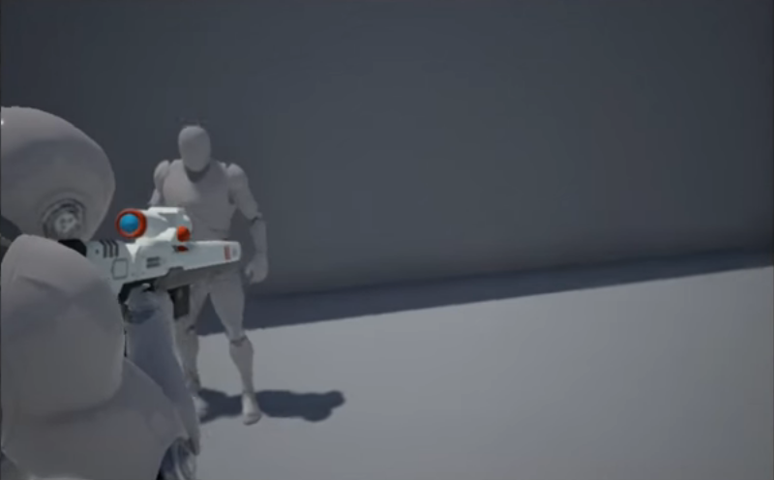
Project Description
Sci-fi third-person shooter online competitive mode based off of games like Uncharted & Halo
Will be made on Unreal Engine 4.
Move towards online connectivity/split screen.

Slide 3
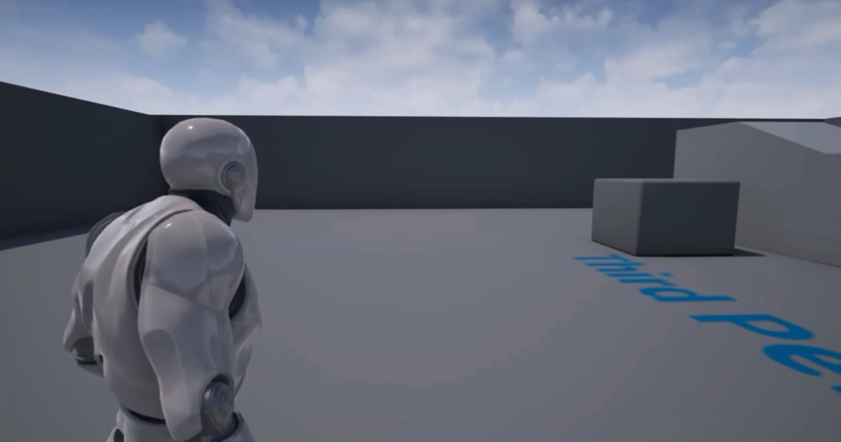
Project description
Control Scheme will satisfy both PC and console gamers.
Start off with a horde mode
Ultimately create an online PVP mode

Slide 4
My interest/FUTURE plans
INTEREST
GAMES! What’s not to like?
Expressing my creativity by creating a game inspired by some of my favorite games.
FUTURE PLANS (if there’s time)
Implement a Team Deathmatch & PVP mode.
Customization!
Eventually work towards making a story-driven campaign.

Slide 5
questions

